Slide 1
Process/ThreadsScheduling
Module 6
ITSC205
Operating Systems Internals

Slide 2
Process/Threads Scheduling
Basic Concepts
Scheduling Criteria
Scheduling Algorithms
Thread Scheduling
Multiple-Processor Scheduling
Real-Time CPU Scheduling
Operating Systems Scheduling Examples

Slide 3
CPU Scheduler
CPU scheduler (also known as short-term scheduler) is a program that selects from the ready queue, based on scheduling algorithms, a process or a thread that should be executed next and allocates the CPU to selected process/thread
Processes and Threads can be described as either:
I/O-bound process/thread – spends more time doing I/O than computations, many short CPU bursts. E.g. sorting, indexing, grouping, import/export data and data transformation
CPU-bound process/thread – spends more time doing computations; few very long CPU bursts. e,.g data classification, complex text mining, natural language processing
Notes:
Reference :Text book chapter 4 page 79 and 80

Slide 4
CPU and I/O Bursts
…
load val
inc val
read file
Threads can be described as either:
I/O-bound – spends more time doing I/O than computations, many short CPU bursts
CPU-bound – spends more time doing computations; few very long CPU bursts
CPU burst
wait for I/O
I/O burst
inc count
add data, val
write file
CPU burst
wait for I/O
I/O burst
load val
inc val
read from file
CPU burst
wait for I/O
I/O burst
…

Slide 5
Process Scheduling
Maximize CPU use, quickly switch processes onto CPU for time sharing
Maintains scheduling queues of processes
Job queue – set of all processes in the system
Ready queue – set of all processes residing in main memory, ready and waiting to execute
Device queues – set of processes waiting for an I/O device
Processes can migrate among the various queues
https://www.youtube.com/watch?v=THqcAa1bbFU

Slide 6
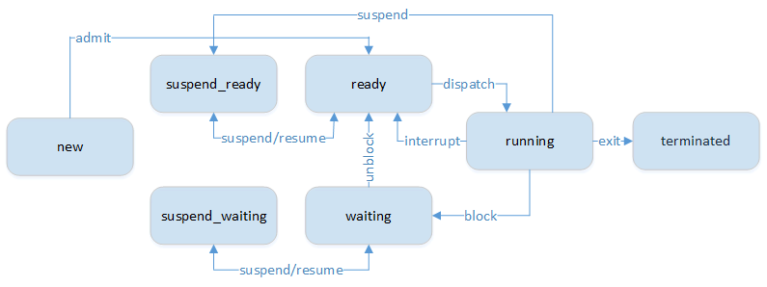
Process State Transitions

Slide 7
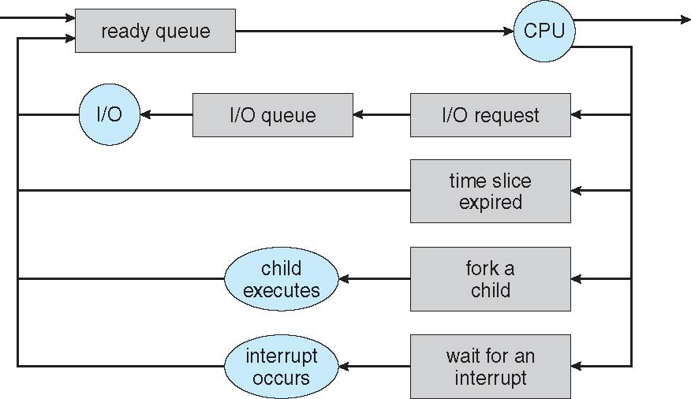
Representation of Process Scheduling

Slide 8
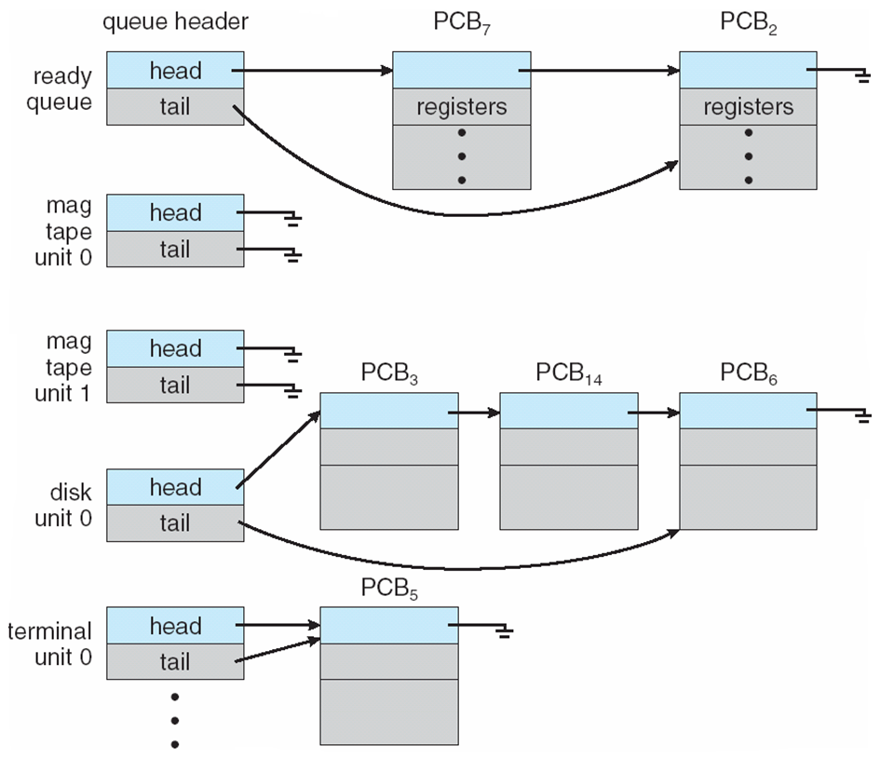
Ready Queue and Various I/O Device Queues

Slide 9
Scheduling strategies
Non-preemptive
Once a process is in the running state, it will continue until it terminates or blocks itself for I/O
Preemptive
Currently running process may be interrupted and moved to the Ready state by the operating system
Allows for better service since any one process cannot monopolize the processor for very long
Notes:
Linux processes are preemptive. If a process enters the TASK_RUNNING state, the kernel checks whether its dynamic priority is greater than the priority of the currently running process.If it is, the execution of current is interrupted and the scheduler in invoked to select another process to run.
A process also can be preemptive when its time quantum expires.
Linux kernel is nonpreemptive .

Slide 10
CPU Scheduler
CPU scheduler is the program that CPU scheduling decisions may take place when a process:
1. Switches from running to waiting state
2. Switches from running to ready state
3. Switches from waiting to ready
4. Terminates
Scheduling under 1 and 4 is nonpreemptive
All other scheduling is preemptive

Slide 11
Scheduling Criteria
CPU utilization – keep the CPU as busy as possible
Throughput – Number of processes that complete their execution per time unit
Turnaround time – amount of time to execute a particular process
Waiting time – amount of time a process has been waiting in the ready queue
Response time – amount of time it takes from when a request was submitted until the first response is produced.
Ensure fairness for all jobs

Slide 12
Process Scheduling Algorithms
FCFS (First-Come, First- Served)
SJF (Shortest Job First)
Priority
Round Robin
Multi-level Queues
https://www.youtube.com/watch?v=2IvSHtBOsEo

Slide 13
First-Come, First-Served
A short process may have to wait a very long time before it can execute
Easy to implement
Ignores service time
Favors CPU-bound processes
I/O processes have to wait until CPU-bound process completes

Slide 14
First-Come, First-Served (FCFS) Scheduling
Process Burst (CPU) Time (ms)
P₁ 24
P₂ 3
P₃ 3
Suppose that the processes arrive in the order: P₁ , P₂ , P₃
P₁
P₂
P₃
0
24
27
30
Turnaround Time for P₁ = 24, P₂ = 27; P₃ = 30 ms
Average Turnaround Time = (24 +27+30) /3 = 27 ms
Waiting time for P₁ = 0; P₂ = 24; P₃ = 27 ms
Average waiting time: (0 + 24 + 27)/3 = 17 ms

Slide 15
Algorithms and their Performance
Process | CPU Burst Time (ms) | Arrival Time | Priority | Classification
P1 | 10 | 0 | 3 | Batch
P2 | 8 | 1 | 1 | Interactive
P3 | 4 | 3 | 4 | Interactive
P4 | 10 | 10 | 2 | Batch
Observation period = 50 ms
Non-preemptive: process will complete its CPU burst before relinquishing the CPU
Preemptive: process can be interrupted by the scheduler and returned to the RQ
Notes:
Note: these are not the same example as the textbook.

Slide 16
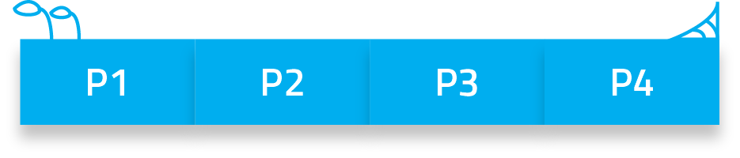
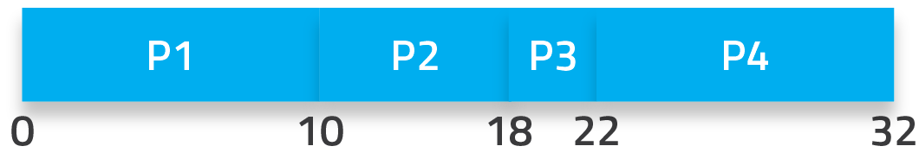
First Come First Serve (FCFS)
Just like FIFO, processes are selected in order of RQ
No overhead
Notes:
Gantt chart – work done over time.

Slide 17
Calculating Performance
Turnaround time (completion – arrival)
P1 = (10 – 0) = 10
P2 = (18 – 1) = 17
P3 = (22 – 3) = 19
P4 = (32 – 10) = 22
Average turnaround time: (10 + 17 + 19 + 22) / 4 = 17 ms

Slide 18
Calculating Performance
Waiting time (dispatch – arrival)
P1 = (0 – 0) = 0
P2 = (10 – 1) = 9
P3 = (18 – 3) = 15
P4 = (22 – 10) = 12
Average waiting time: (0 + 9 + 15 + 12) / 4 = 9 ms

Slide 19
Calculating Performance
Throughput ( total # processes completed in observed time)
Observed time = 50 ms, processes completed = 4
= 4
CPU utilization (CPU used / observed time * 100%)
= 32 / 50 * 100
= 64%

Slide 20
Quantum
“A quantum is the amount of time a process or thread gets to run before Windows checks to see whether another thread at the same priority is waiting to run. If a thread completes its quantum and there are no other threads at its priority, Windows permits the thread to run for another quantum”.
“Quantum value depends on operating systems and CPU architecture. e.g Windows client operating systems, threads run by default for 2 clock intervals; on Windows Server systems, by default, a thread runs for 12 clock intervals. The rationale for the longer default value on server systems is to minimize context switching. By having a longer quantum, server applications that wake up as the result of a client request have a better chance of completing the request and going back into a wait state before their quantum ends” -Windows Internals Part 1

Slide 21
Shorter quantum yields more context switches
Thread execution time: 15
context switches
quantum
20
0
0
15
10
1
0
10
15
1
14
0
10
15

Slide 22
Round Robin (RR)
Preemptive algorithm.
It is one of the most widely used algorithms
Clock interrupt is generated at periodic intervals, when an interrupt occurs, the currently running process is placed in the ready queue
The time assigned to the process is known as time slicing (Quantum). Each process gets a small unit of CPU time (time quantum q), usually 10-100 milliseconds. After this time has elapsed, the process is preempted and added to the end of the ready queue.

Slide 23
Round Robin (RR)
If there are n processes in the ready queue and the time quantum is q, then each process gets 1/n of the CPU time in chunks of at most q time units at once.
Timer interrupts every quantum to schedule next process
Performance
large quantum ⇒ FIFO
small quantum ⇒ too many context switch, overhead is too high
To check the current quantum do the following:
In Linux: cat /proc/sys/kernel/scheduler_rr_timelices_ms
In Windows: run clockres64 utility from System-internals Suite

Slide 24
Round -Robin
Process Arrival Time(ms) CPU Time (ms)
P₁ 0.0 7
P₂ 2.0 4
P₃ 4.0 1
P₄ 5.0 4
Average waiting time : (9+5+0+4)/4 = 4.5ms
Average turnaround time : (( 16-0)+(11-2)+( 5-4)+(13-5))/4 = 8.5 ms
Quantum = 2ms
P₁
P₂
P₃
P₄
P₁
P₂
P₄
P₁
P₁
0
2
4
5
7
9
11
13
15
16
Notes:
This example (RR) represents execution of 4 process with same arrival and CPU cycle as SJN and quantum 2 msec.
P1 waited between 2 and 7 and between 9 and 13 that is 5 +4=9 msec
P1 finished at 16 minus arrival time 0 = 16msec
P2 waited between 4 and 9 that is 5 msec
P2 finished at 11 minus arrival time 2 = 9 msec.
More examples Text book pages 92 and 93

Slide 25
Priority Scheduling
Preemptive and Non-Preemptive Algorithm
A priority number (integer) is associated with each process
Scheduler will always choose a process of higher priority over one of lower priority
Have multiple ready queues to represent each level of priority
The CPU is allocated to the process with the highest priority
(In Linux - smallest integer ≡ highest priority)
Problem ≡ Starvation – low priority processes may never execute
Solution ≡ Aging – as time progresses increase the priority of the process

Slide 26
Starvation
Priority algorithms suffer from starvation – where low priority processes may never get to execute!
Being “starved” out of the CPU
To solve this problem, we can use the aging technique
Increase priority of processes as they wait in the RQ
Implies priority is dynamic, not static and fixed for the duration of a process’s life
Can be adjusted internally by the OS or externally by users or applications

Slide 27
Example of Priority Scheduling
ProcessA Burst(CPU)Time(ms)T Priority
P₁ 10 3
P₂ 1 1
P₃ 2 4
P₄ 1 5
P₅ 5 2
Average Turnaround Time = (16+1+18+19+6 )/5= 12ms
Average waiting time = (6 + 0+16+18+1)/5=8.2 ms
P₂
P₅
P₁
P₃
P₄
0
1
6
16
18
19

Slide 28
Algorithms and their Performance
Process | CPU Burst Time (ms) | Arrival Time | Priority | Classification
P1 | 10 | 0 | 3 | Batch
P2 | 8 | 1 | 1 | Interactive
P3 | 4 | 3 | 4 | Interactive
P4 | 10 | 10 | 2 | Batch
Observation period = 50 ms
Non-preemptive: process will complete its CPU burst before relinquishing the CPU
Preemptive: process can be interrupted by the scheduler and returned to the RQ
Notes:
Note: these are not the same example as the textbook.

Slide 29
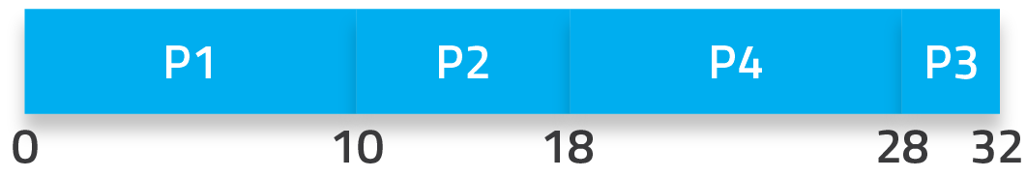
Non-Preemptive Priority
Based on value assigned by OS or user to each process
Higher priority = more “important” = needs to execute first!
Depending on the OS implementations, “high” can be the smallest or largest value used.
i.e. 0 is highest in Linux, but lowest in Windows
We’ll assume 1 is highest for this example
Notes:
Waiting time (dispatch – arrival)
P1 = (0 – 0) = 0
P2 = (10 – 1) = 9
P3 = (28 – 3) = 25
P4 = (18 – 10) = 8
Average waiting time: 10.5 ms.
Turnaround time (completed – arrival)
P1 = (10 – 0) = 10
P2 = (18 – 1) = 17
P3 = (32 – 3) = 29
P4 = (28 – 10) = 18
Average turnaround time: 18.5 ms

Slide 30
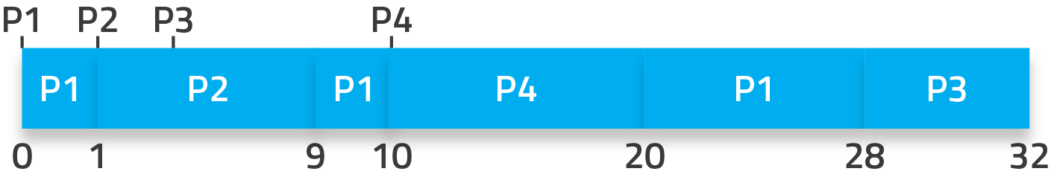
Preemptive Priority
Same idea, but now a higher priority process can “kick out” a lower priority process that is currently executing
Notes:
Waiting time (dispatch – arrival) [+ next dispatch – preempted]
P1 = (0 – 0) + (9 – 1) + (20 – 10) = 18
P2 = (1 – 1) = 0
P3 = (28 – 3) = 25
P4 = (10 – 10) = 0
Average waiting time: 10.75 ms.
Turnaround time (completed – arrival)
P1 = (28 – 0) = 28
P2 = (9 – 1) = 8
P3 = (32 – 3) = 29
P4 = (20 – 10) = 10
Average turnaround time: 18.75 ms

Slide 31
CPU Scheduling Algorithms
https://www.youtube.com/watch?v=1ikcIKDGEz4

Slide 32
Multilevel Queue
Ready queue is partitioned into separate queues, eg:
foreground (interactive)
background (batch)
Each queue has its own scheduling algorithm:
foreground – RR
background – FCFS
Scheduling must be done between the queues:
Fixed priority scheduling; (i.e., serve all from foreground then from background). Possibility of starvation.
Time slice – each queue gets a certain amount of CPU time which it can schedule amongst its processes; i.e., 80% to foreground in RR
20% to background in FCFS

Slide 33
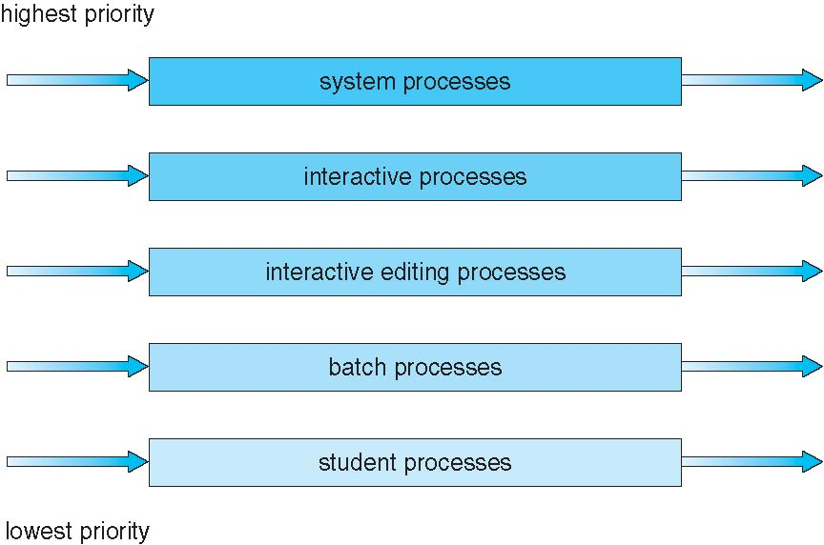
Multilevel Queue Scheduling

Slide 34
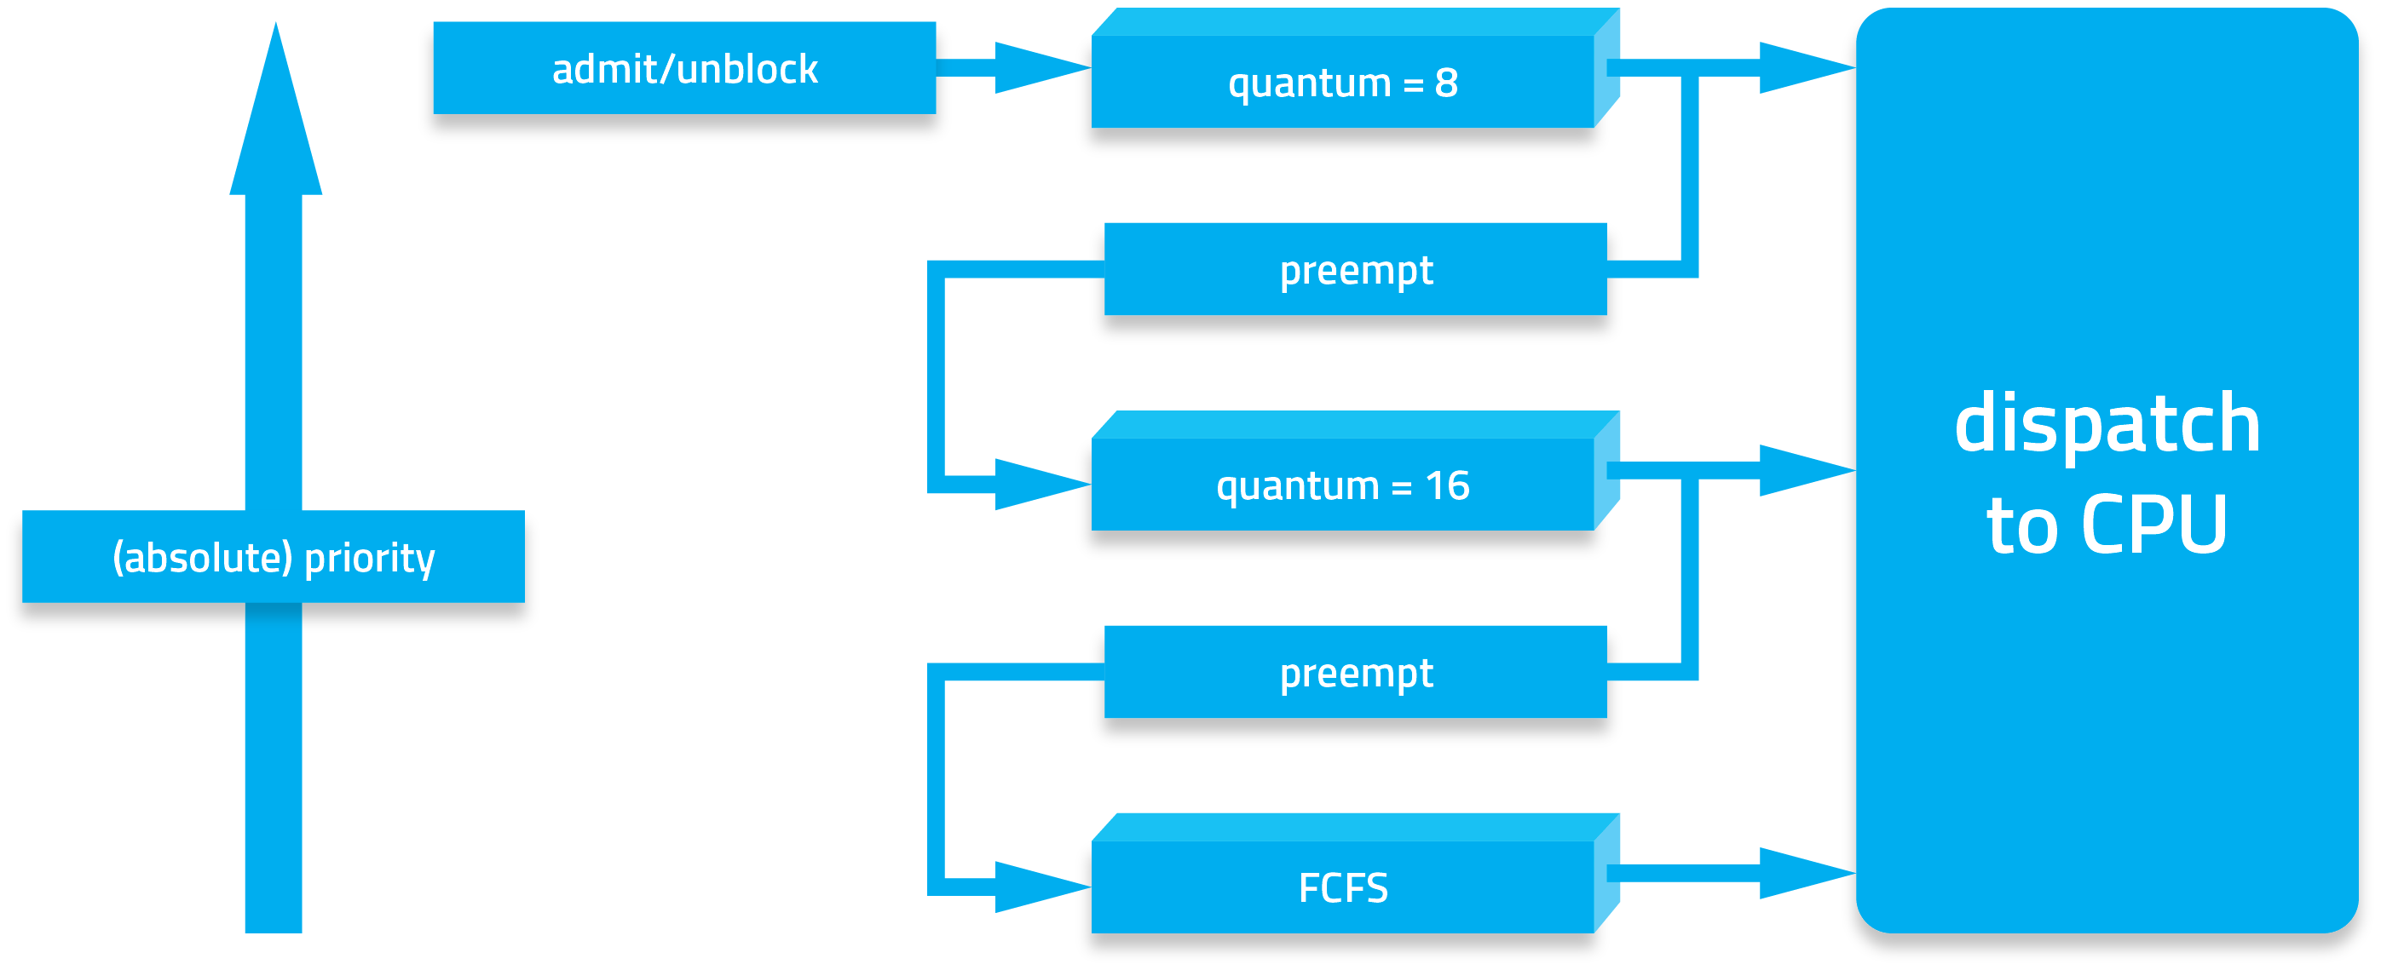
Multilevel Feedback Queues

Slide 35
Windows Scheduling
Windows implements a preemptive scheduler. Windows uses priority-based preemptive scheduling. Highest-priority thread runs next. If a thread with a higher priority becomes ready to run, the currently running thread might be preempted before finishing its time slice. In fact, a thread can be selected to run next and be preempted before even beginning its quantum!

Slide 36
Windows Scheduling
Thread runs until:
It is done (task is completed)
Blocks for I/O. It enters into a wait state
Uses time slice (quantum expires). It yields execution.
The thread is preempted by higher-priority thread
Thread priority changes, either because of a system service call or Windows itself changes the priority value
Thread’s processor affinity changes so it will no longer run on the processor on which it was running

Slide 37
Windows Scheduling
Real-time threads can preempt non-real-time
Windows supports 32-level priority scheme.
Variable class is 1-15, real-time class is 16-31
Priority 0 is memory-management thread
There is a queue for each priority
If no runnable thread, the system runs idle thread
https://msdn.microsoft.com/en-us/library/windows/desktop/ms685100%28v=vs.85%29.aspx

Slide 38
Windows Priority Classes
Win32 API identifies several priority classes to which a process can belong
REALTIME_PRIORITY_CLASS, HIGH_PRIORITY_CLASS, ABOVE_NORMAL_PRIORITY_CLASS,NORMAL_PRIORITY_CLASS, BELOW_NORMAL_PRIORITY_CLASS, IDLE_PRIORITY_CLASS
All are variable except REALTIME
A thread within a given priority class has a relative priority
TIME_CRITICAL, HIGHEST, ABOVE_NORMAL, NORMAL, BELOW_NORMAL, LOWEST, IDLE

Slide 39
Windows Priority Classes
Priority class and relative priority combine gives numeric priority
Base priority is NORMAL within the class
If quantum expires, priority lowered, but never below base
If wait occurs, priority boosted depending on what was waited for
Foreground window given 3x priority boost

Slide 40
Windows Priorities

Slide 41
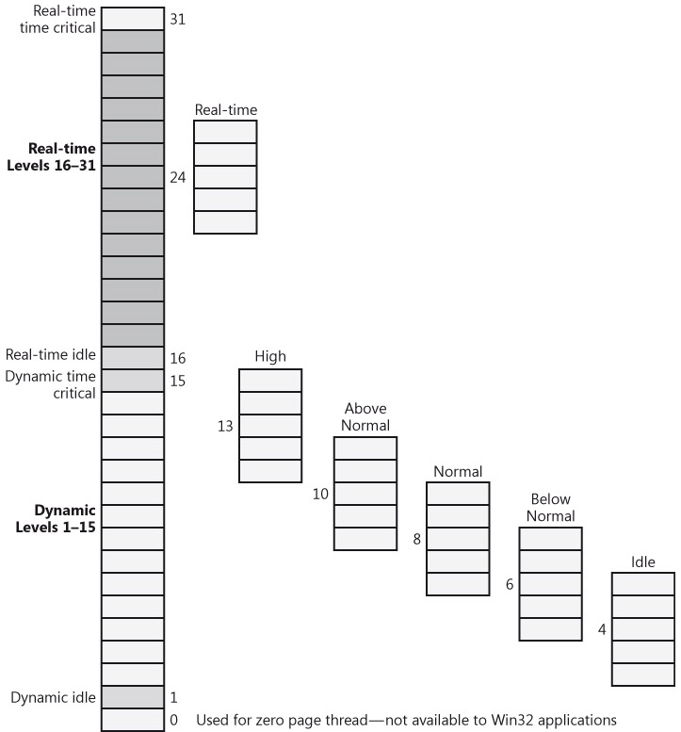
Windows Process Scheduling

Slide 42
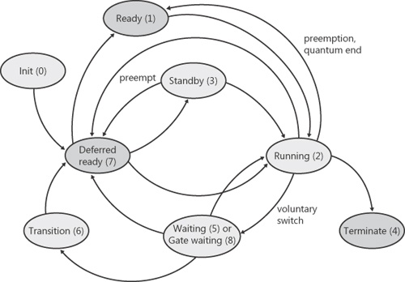
Windows Threads Scheduling
Notes:
The thread states are
Ready A thread in the ready state is waiting to execute. When looking for a thread to execute, the dispatcher considers only the pool of threads in the ready state.
Standby A thread in the standby state has been selected to run next on a particular processor. When the correct conditions exist, the dispatcher performs a context switch to this thread.
Running Once the dispatcher performs a context switch to a thread, the thread enters the running state and executes. The thread's execution continues until its quantum ends (and another thread at the same priority is ready to run), it is preempted by a higher priority thread, it terminates, it yields execution, or it voluntarily enters the wait state.
Waiting A thread can enter the wait state in several ways: a thread can voluntarily wait for paging I/O, or an environment subsystem can direct the thread to suspend itself. When the thread's wait ends, depending on the priority, the thread either begins running immediately or is moved back to the ready state.
Transition A thread enters the transition state if it is ready for execution but its kernel stack is paged out of memory. Once its kernel stack is brought back into memory, the thread enters the ready state.
Terminated When a thread finishes executing, it enters the terminated state. Once the thread is terminated, the executive thread block might or might not be de-allocated.

Slide 43
Linux Scheduling
Linux implements Completely Fair Scheduler (CFS)
CFS is implemented as Red-Black Tree (rbtree.h). When a task is runnable is added to the tree.
CFS scheduler maintains per task virtual run time in variable vruntime. Processes with less processing time have small values of vruntime and are on the left side of the tree. Processes with more processing time are on the right side
To decide next task to run, scheduler picks task with lowest virtual run time (highest priority) which are located on the left side of the tree

Slide 44
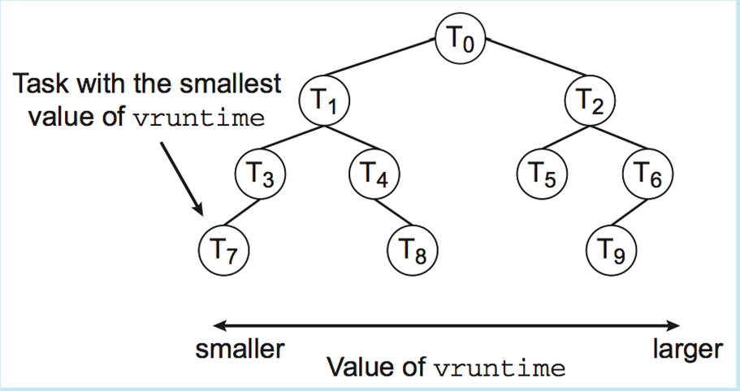
Completely Fair Scheduler (CFS)

Slide 45
Linux Scheduling
Scheduling classes
There are two scheduling classes:
default
real-time
Each class has specific priority
Scheduler picks highest priority task in highest scheduling class
Scheduling classes
SCHED_FIFO: Real-time processes. First-in-first-out
algorithm
SCHED_RR: Real-time processes. Round-Robin algorithm
SCHED_OTHER: Default –Time Sharing (TS) processes. It implements priority algorithm
Notes:
In Linux each process has a base time quantum value assigned by the scheduler.
The user can change the base time quantum of the processes using nice( ) and setpriority( ) system calls
Linux adopted the rule of thumb to choose the quantum duration: Choose a duration as long as possible , while keeping good system response time.
The Fields related to scheduling included in the process descriptor are:
1. need_resched : A flag to decide whether to invoke the schedule( )
function
2. Policy :SCHED_FIFO: First-in-first-out real-time threads
SCHED_RR: Round-robin real-time threads
SCHED_OTHER: Other, non-real-time threads (time –sharing)
Linux called real time threads in conformant to the P1003.4 standard
3. Priority : The base time quantum of the process
4. Counter : The number of ticks of CPU time left to the process before its quantum expires

Slide 46
Linux Scheduling
SCHED_OTHER: Default –Time Sharing (TS) processes. Quantum calculated based on nice value from -20 to +19
Lower value is higher priority
ps –c command displays process’ class: Time Sharing(TS) or Real Time (RT)
Linux chrt command can be used to display scheduling attributes of all tasks for a given PID

Slide 47
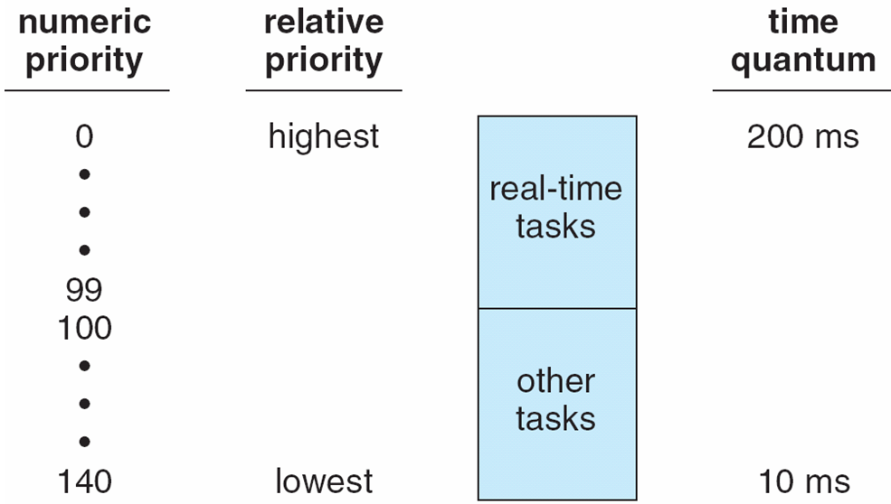
Priorities and Time-slice length

Slide 48
Scheduling Time Sharing (TS) processes
In Linux time sharing processes can be schedule using the nice command
The system uses nice attribute to determine process priority compared to other processes.
Increasing the values of nice decreases process’ priority
Default value of nice = 0
Nice range is -20 > Nice < 19
nice -n -10 ps -increases process ps priority
nice -n 10 ps -decreases process ps priority by 10 units
Only TS processes can be niced
Real Time process CAN NOT be niced

Slide 49
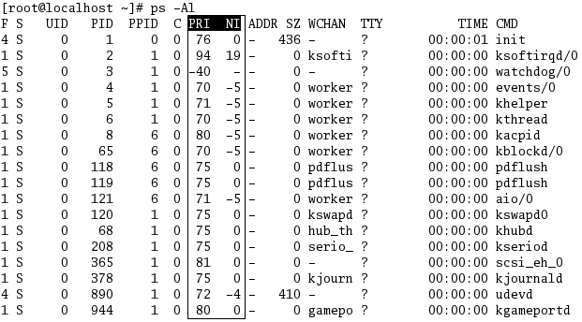
NICE Value

Slide 50
Multiple-Processor Scheduling
CPU scheduling more complex when multiple CPUs are available
Asymmetric multiprocessing – only one processor accesses the system data structures, alleviating the need for data sharing. One CPU manages scheduling , it makes decision on next process to use a specific CPU. This CPU is known as master server, the other CPUs execute only code
Symmetric multiprocessing (SMP) – Each CPU manages its own scheduling. All processes may be in a common ready queue, or each CPU may have its own private queue of ready processes. Each CPU uses its own scheduler to select a process to execute
Currently, most common

Slide 51
Multiprocessor Scheduling
Multi-core are faster than multiprocessor
This extra speed led to a discovery of memory stalls – CPU waiting for data during an instruction
Spends more than half the time during an instruction cycle idling
H/W threads (Hyper-threading)
When one thread stalls on memory, switch to the other one!
Appears as its own virtual (logical) processor
OS schedules each logical CPU separately

Slide 52
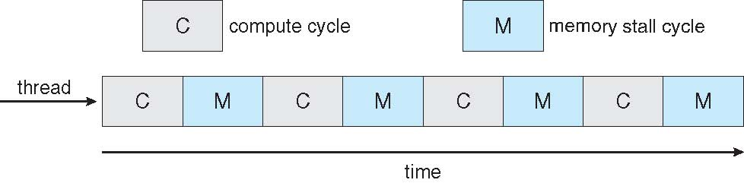

Multithreaded Multicore System

Slide 53
Processor Affinity
Processor affinity – It keeps processes running on the same CPU. Process has affinity for processor on which it is currently running. SMP systems avoids migration of processes among CPUs because that causes caches.
Two types of affinity
Soft affinity: OS has a policy to keep processes running on same CPU but there is not guarantee to keep this policy
Hard affinity: OS will specify a subset of CPUs on which processes may run
Linux supports both

Slide 54
Virtualization and Scheduling
Virtualization software schedules multiple guests onto CPU(s)
Each guest doing its own scheduling
Not knowing it does not own the CPUs
Can result in poor response time
Can effect time-of-day clocks in guests
Can undo good scheduling algorithm efforts of guests

Slide 55
References
Microsoft Threading
https://docs.microsoft.com/en-us/dotnet/standard/threading/threads-and-threading
Microsoft Scheduling Threads
https://docs.microsoft.com/en-us/dotnet/standard/threading/scheduling-threads
Processor affinity
https://www.glennklockwood.com/hpc-howtos/process-affinity.html

Slide 56
References
Silberschatz, Galvin and Gagne, Operating System Concepts with Java, John Wiley & Sons, latest edition.
Process Scheduling

